Slide 1

SRM INSTITUTE OF SCIENCE AND TECHNOLOGY
SCHOOL OF COMPUTING
DEPARTMENT OF COMPUTING TECHNOLOGIES
18CSP109L- MAJOR PROJECT
AI-Powered Early Diagnosis and Personalized Health Recommendations for Coronary Artery Disease (CAD) using Predictive Analytics
Batch ID: CTB07806
TEAM :
Student 1: (RA2111003010710) Khayati Sharma
Student 2: (RA2111003010606) Siddharth Vats
Project Guide Name : Dr. M. Revathi
Designation: Assistant Professor Department of Computing Technologies

Slide 2
Table of Contents
Abstract
Introduction
Existing System
Literature Review
Problem Statement
Proposed System
Architecture
Objectives
Objectives Achieved
References

Slide 3
Abstract
AI-driven framework for early prediction of Coronary Artery Disease (CAD)
Uses 13 clinical parameters for accurate diagnosis
Ensemble model: Logistic Regression, Random Forest, SVM
Includes AI Chemist for medication-related queries via Google Gemini
Offers health advice and chatbot for user guidance

Slide 4
Introduction
CAD is a leading cause of death globally
Early detection can prevent complications and mortality
Traditional methods are slow, costly, or inaccessible
AI can improve diagnostics, accessibility, and patient education

Slide 5
Existing System
Traditional methods:
Manual diagnosis based on ECG, angiograms, and clinical tests
Time-consuming and requires medical expertise
No integrated system for prediction combined with medication support
Machine learning models:
Single-model based (lack robustness)
Difficult to interpret (black-box nature)
Lacking personalized recommendations

Slide 6
Literature Review
Authors | Summary | Methods Used | Dataset | Key Contributions | Limitations
[1] Ramalingam, V. V., Dandapath, A., & Raja, M. K. | Discusses the global prevalence of cardiovascular diseases and role of ML in prediction. | Various machine learning methods. | Not specified. | Emphasizes the potential of ML in early detection and reducing CVD mortality. | Notes that while ML shows promise, practical application in clinical settings needs further development.
[2] Fatima, M., & Pasha, M. | Surveys machine learning algorithms for heart disease prediction and highlights their potential. | Various machine learning algorithms. | Multiple datasets from UCI repository. | Demonstrates that ML algorithms enhance prediction accuracy in cardiovascular studies. | Statistical models are less effective with complex patterns.
[3] Chaurasia, D. V., & Pal, S. | Addresses cardiovascular disease prediction using a comparative study of machine learning models. | Various data mining algorithms. | Hungarian Institute of Cardiology dataset. | Surveys current machine learning techniques, comparing their performance. | Lack of deep learning-based methods and real-time analysis capabilities.

Slide 7
Literature Review
Authors | Summary | Methods Used | Dataset | Key Contributions | Limitations
[4] Patel, J., TejalUpadhyay, D., & Patel, S. | Predicts heart disease using data mining techniques and compares multiple algorithms. | Various data mining algorithms including J48. | Cleveland dataset from UCI repository. | Presents a model that improves heart disease prediction. | J48 algorithm has interpretability limitations.
[5] Rindhe, B. U., Ahire, N., Patil, R., Gagare, S., & Darade, M. | The research paper focuses on predicting heart disease using machine learning algorithms, highlighting the need for accurate diagnostic systems due to the high mortality rates associated with heart diseases globally. | The research paper employs various machine learning techniques for heart disease prediction, including Artificial Neural Networks (ANN), Random Forest, and Support Vector Machines (SVM). | The study primarily utilized the Cleveland dataset, which contains 303 samples and 14 input features, along with 1 output feature related to heart disease prediction. | The paper highlights that machine learning can significantly improve cardiovascular risk prediction, addressing the limitations of current approaches that fail to identify many individuals who could benefit from preventive treatment. | The provided contexts do not mention any specific limitations related to the research paper on heart disease prediction using machine learning. Therefore, there is no information available regarding the limitations discussed in the paper.

Slide 8
Problem Statement
Need for a reliable and interpretable heart disease prediction model
Patients struggle with understanding medications
No unified platform combining risk detection + health assistance
Existing ML models lack hybrid robustness
A system is required that:
- Combines multiple models for better accuracy.
- Gives actionable health recommendations based on predictions.
- Clears the patients doubts and queries in real time.

Slide 9
Proposed System
AI model predicts CAD risk using clinical inputs
Soft voting ensemble: Logistic Regression, Random Forest, SVM
AI Chemist: drug interaction checker and guidance assistant
Chatbot and lifestyle recommendation engine included
User friendly and highly intuitive user-interface

Slide 10
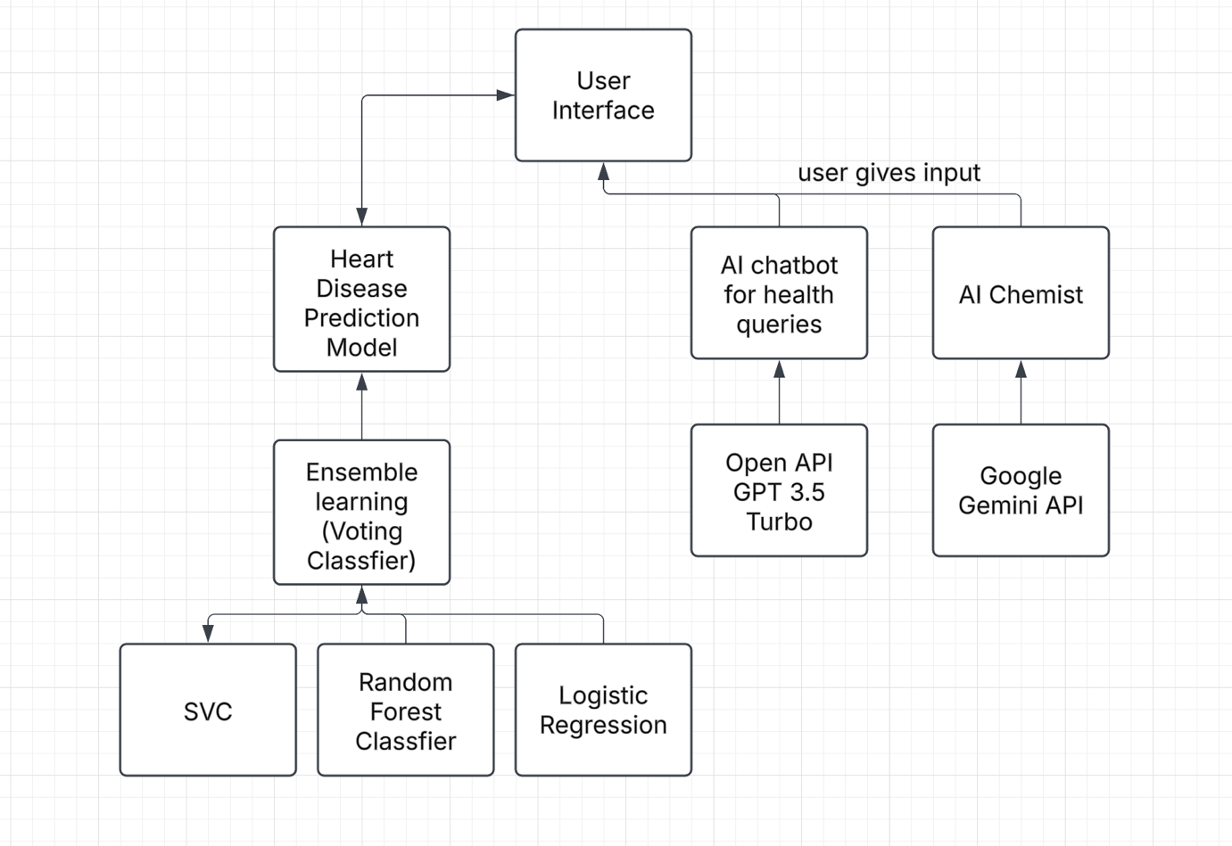
Architecture

Slide 11
Objectives
Pre-process the Cleveland heart dataset from UCI Machine Learning Repository
Improve prediction accuracy by developing a hybrid ensemble learning method combining Support Vector Machine, Random Forest and Logistic Regression
Develop a streamlit-based interactive web app
Provide personalized lifestyle recommendations
Integrate a chatbot for answering the user’s health related queries
Improve patient understanding and self-care

Slide 12
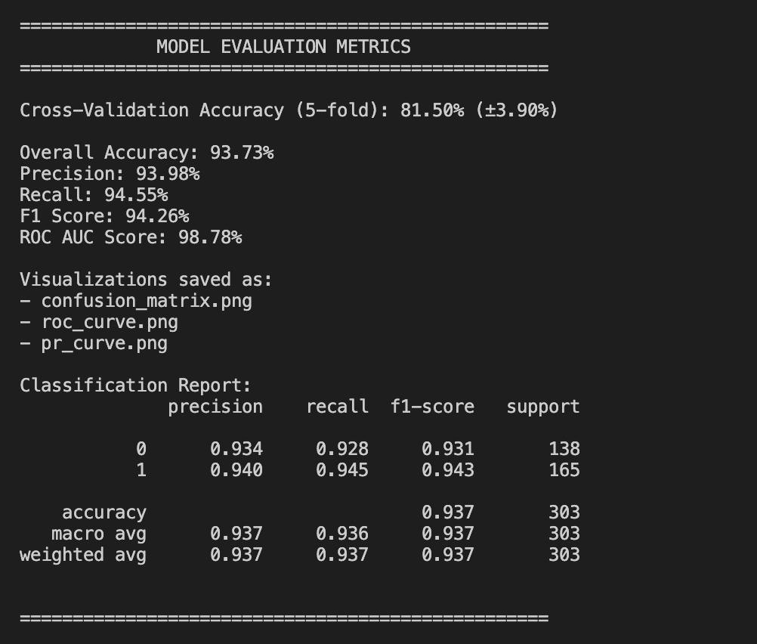
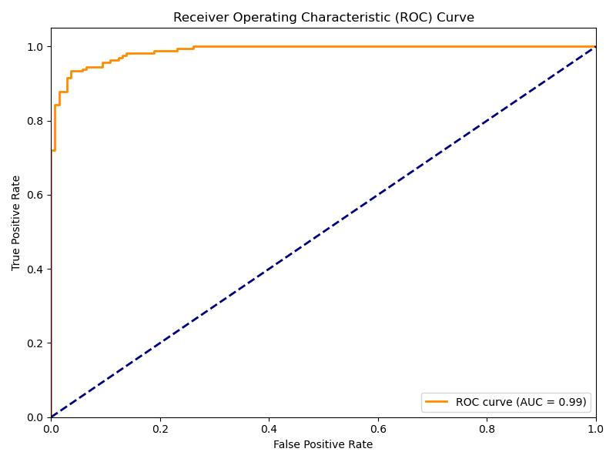
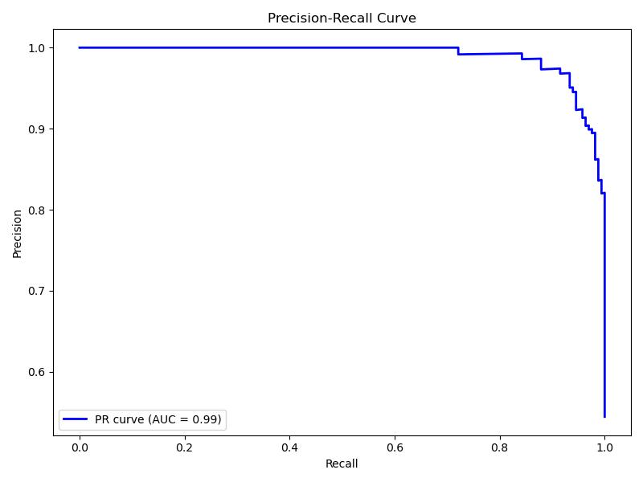
Objectives Achieved
Pre-processed the Cleveland heart dataset from UCI Machine Learning Repository
Improved prediction accuracy by developing a hybrid ensemble learning method combining Support Vector Machine, Random Forest and Logistic Regression

Slide 13
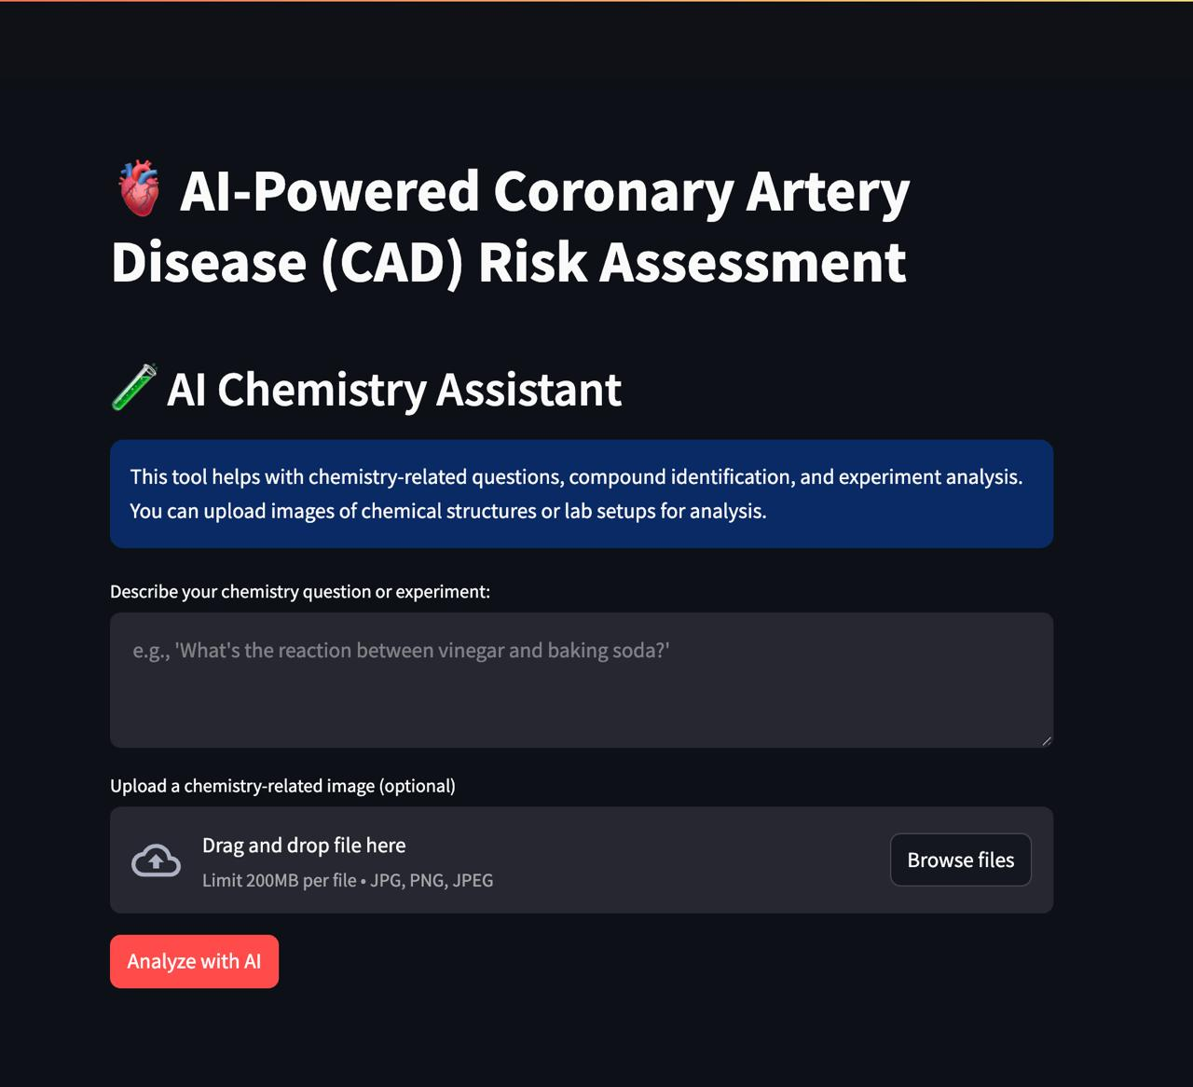
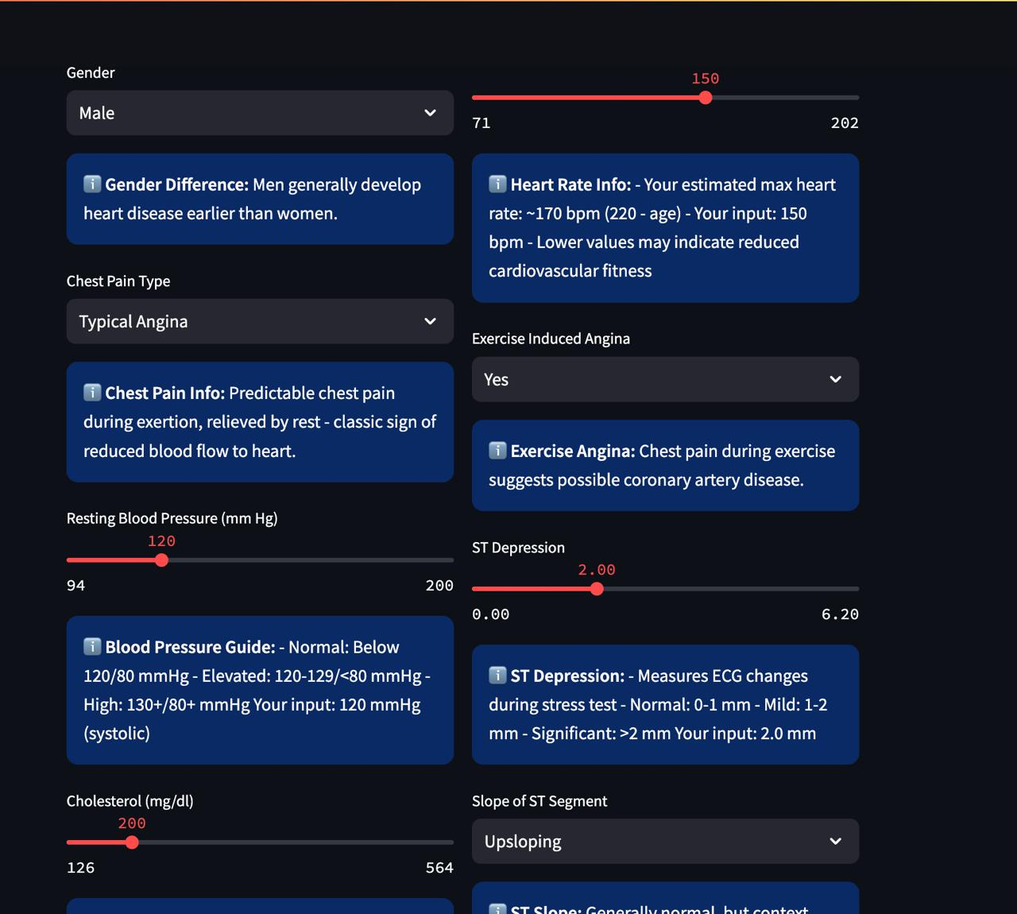
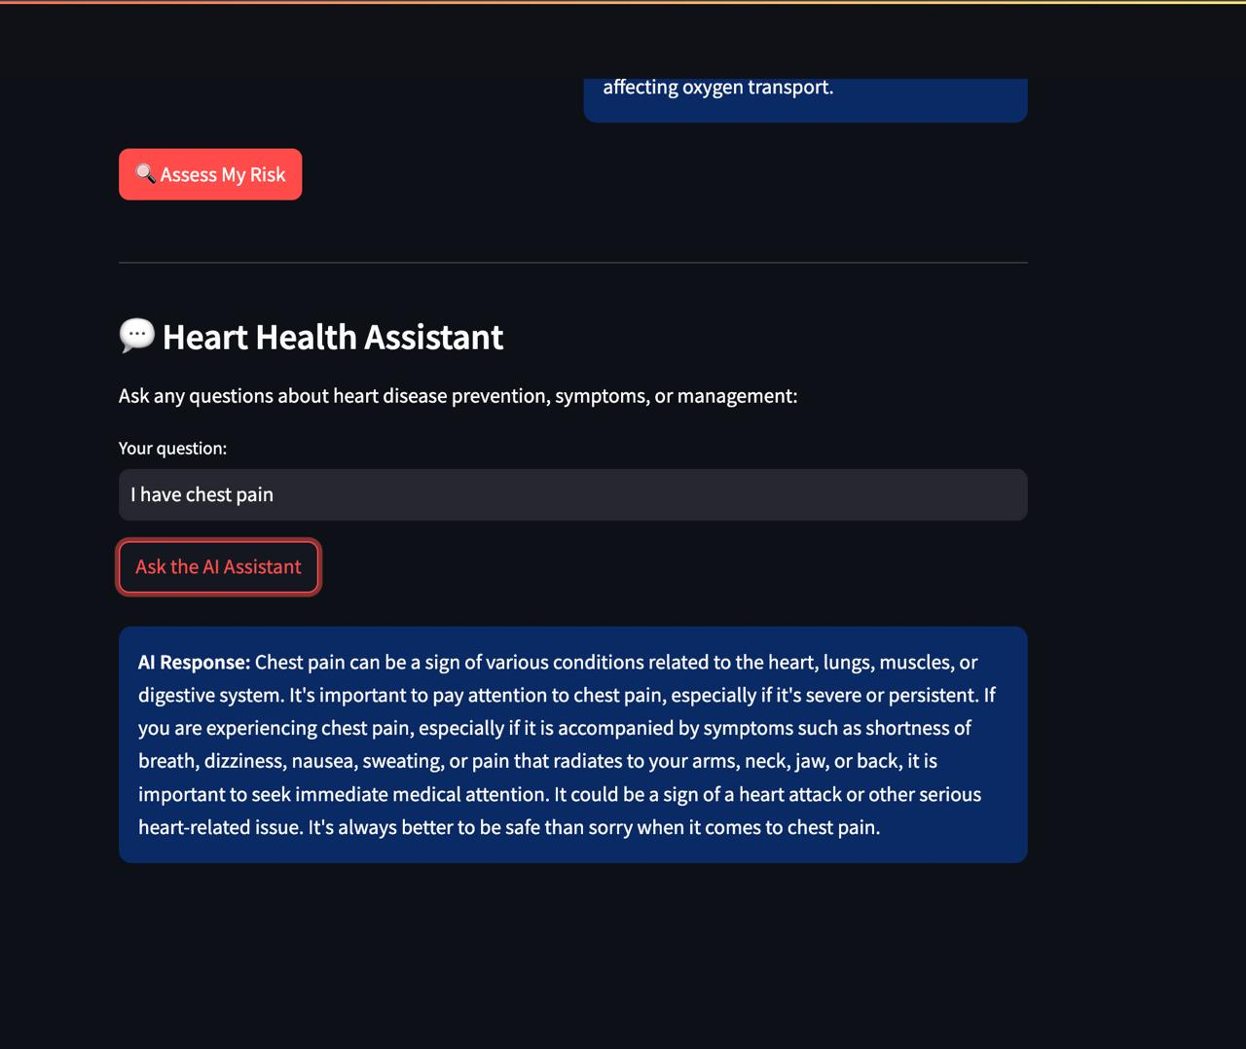
Objectives Achieved
Developed a streamlit-based interactive web app.
Suggest health recommendations based on prediction results.
Integrate a chatbot for answering the user’s health related queries.

Slide 14
References
[1] Ramalingam, V. V., Dandapath, A., & Raja, M. K. (2018). Heart disease prediction using machine learning techniques: a survey. International Journal of Engineering & Technology, 7(2.8), 684-687. [2] Fatima, M., & Pasha, M. (2017). Survey of machine learning algorithms for disease diagnostic. Journal of Intelligent Learning Systems and Applications, 9(01), 1-16.
[3] Chaurasia, D. V., & Pal, S. (2014). Data mining approach to detect heart diseases. International Journal of Advanced Computer Science and Information Technology (IJACSIT) Vol, 2, 56-66.
[4] Patel, J., TejalUpadhyay, D., & Patel, S. (2015). Heart disease prediction using machine learning and data mining technique. Heart Disease, 7(1), 129-137.
[5] Rindhe, B. U., Ahire, N., Patil, R., Gagare, S., & Darade, M. (2021). Heart disease prediction using machine learning. Heart Disease, 5(1).

